Slide 1
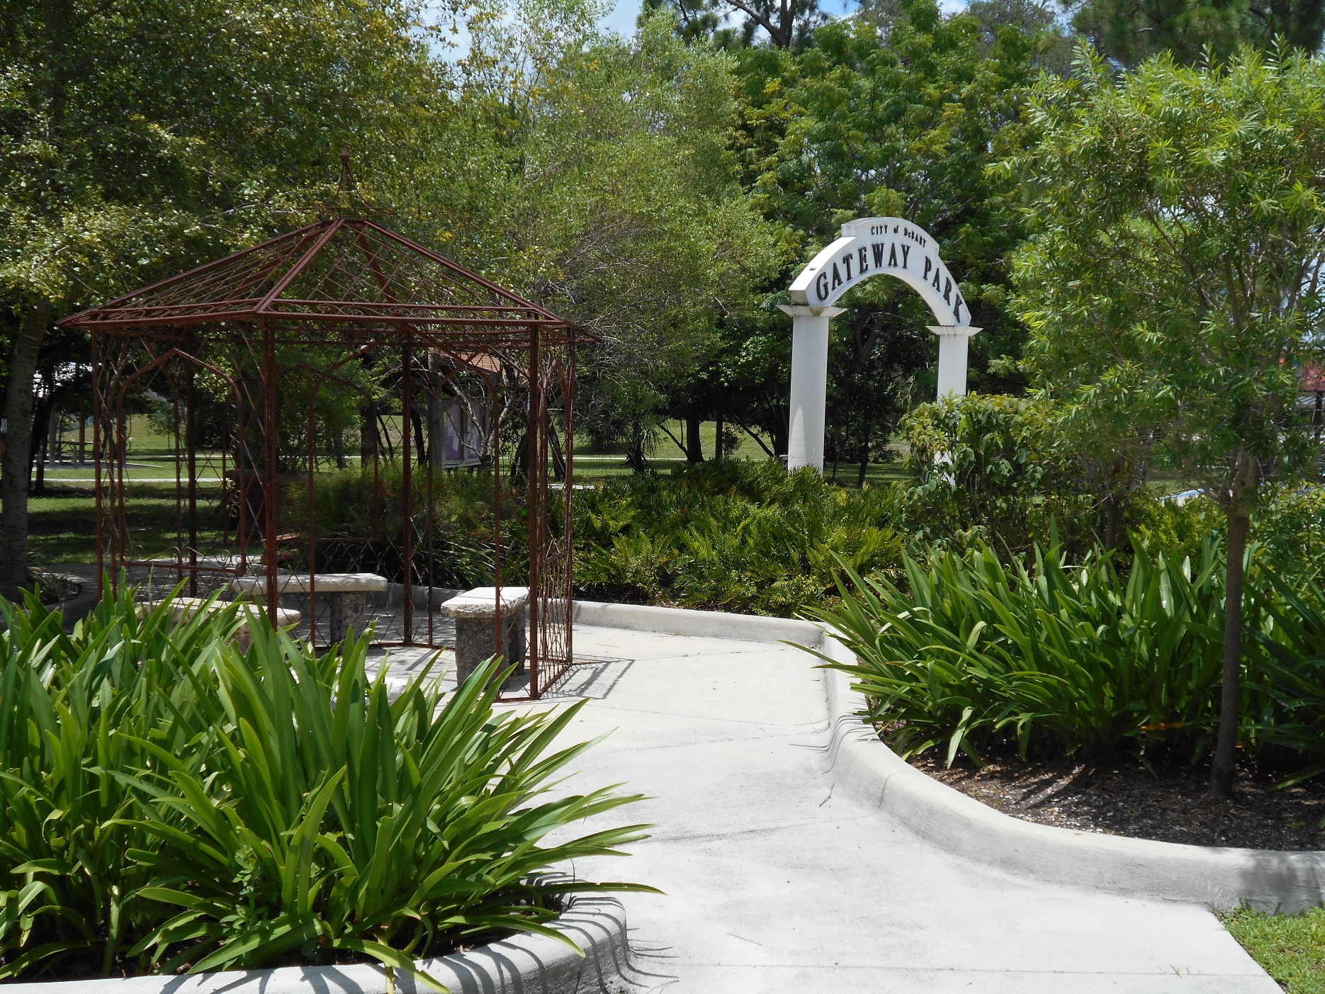
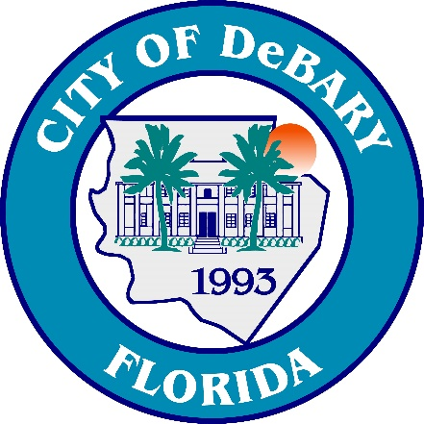
DIRECTOR OF
ECONOMIC DEVELOPMENT
DeBary, Florida

Slide 2
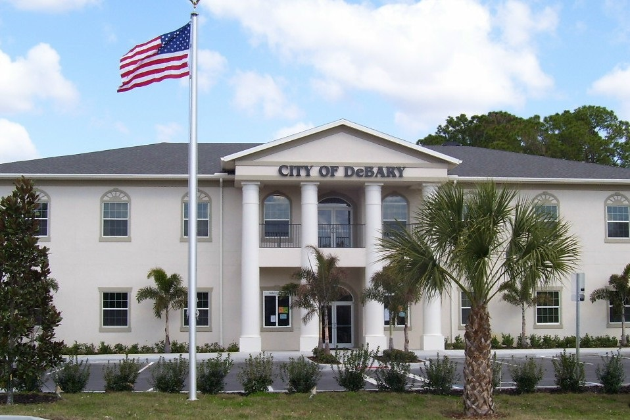
THE COMMUNITY
DeBary, Florida is located on the northern shore of the beautiful St. Johns River. It is the gateway to southwestern Volusia County and serves as a corridor between Orlando, Sanford and Daytona Beach. Serving a population of 21,900, DeBary occupies 25 square miles. DeBary offers small-town living that is on the cusp of something, well….more than you imagined!
DeBary was settled in 1871, by a wine merchant Samuel Frederick deBary erected a winter home. DeBary Hall has been restored and is open to the public with artists, displays, multimedia programs and docent-led tours. The DeBary Hall Historic Site was placed on the National Register of Historic Places in 1972.
DeBary offers a diversity of lifestyles, which include upscale country clubs and championship golf courses, rural acreage with horses and riverside homes. Environmentally-sensitive areas and agricultural areas of the City are separated from low-to-medium density residential areas by a power plant, community park, and a subdivision of one-acre home sites with a rural/residential zoing classification.
Events held each year in the City include our 4th of July Celebration, Christmas Parade, Tree Lighting Ceremony with a Chili Cook Off, Halloween and Christmas Light decorating contest.
The Gateway Center for the Arts conducts several theatrical performances, art festivals, Youth Celebration of the Arts and concerts by the Gateway Orchestra. Many other event organizers coordinate events with the City year round to include races, food trucks, farmers markets, sports tournaments, festivals and more!
Parks located in the City vary from neighborhood playgrounds and sports complexes to a large 108-acre nature park that boasts a world-class 36 hole disc golf course.
The Mayor and City Council are exceptionally business-friendly and actively encourage new business to locate in DeBary. DeBary enjoys one of the lowest ad valorem tax rates in Volusia County. An experiment in innovative government, DeBary is an ideal candidate to serve as a model to other communities.
A community that emphasizes quality of life and quality of services, DeBary stands out in terms of distinctive character, charm and resources. It is the ultimate small-town living with friendly citizens, sunny climate, and an open-door City Council; a town that is progressive, yet has retained its unique southern charm.

Slide 3
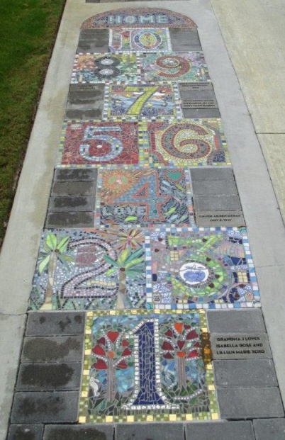
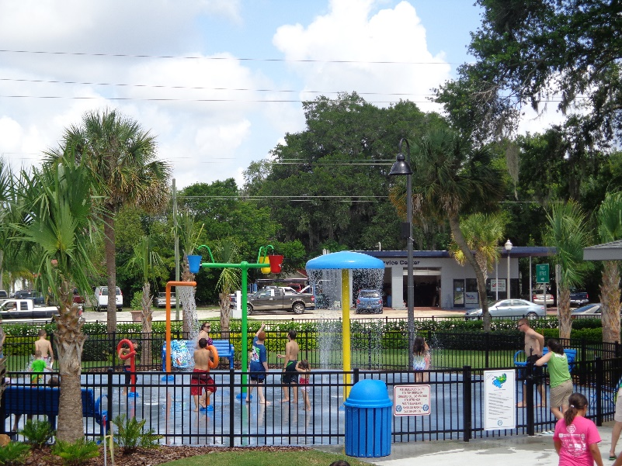
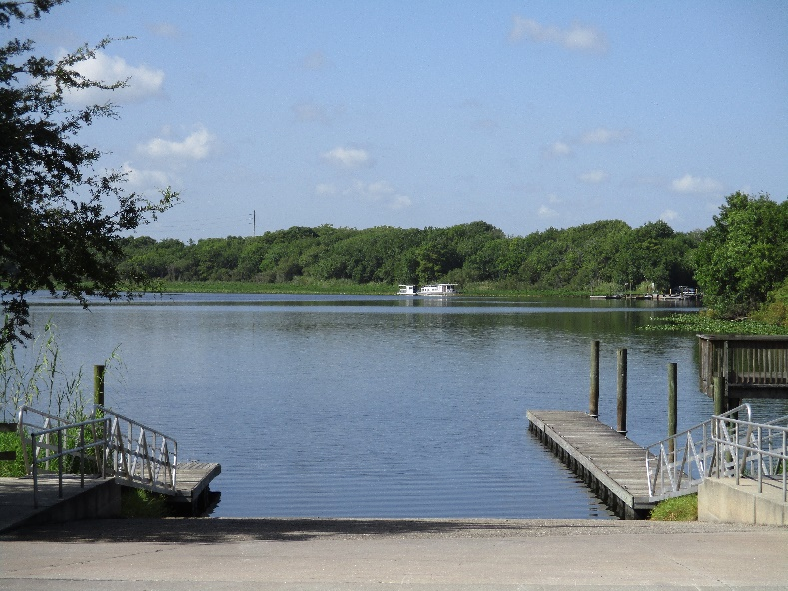
THE COMMUNITY CONTINUED
The City of DeBary is at a turning point. With exciting new leadership in place, City leaders are embarking on a two-pronged effort of correcting long-standing issues while simultaneously creating innovative concepts incorporating our unique assets: a historic river-front city with the only Sun Rail stop in Volusia County, a community that straddles Volusia and Seminole Counties, moderate tax climate and low crime rate contributes to our quality of life and makes DeBary a great place for business.
DeBary residents have expressed a desire for more mixed-use communities. Imagine a place that offers a unique and varied quality of life that includes more than 1000 acres of recreational parks and conservation lands within a 5-15 minute walk. Add in three (3) regional trail systems totaling more than 600 miles that intersect naturally at The new DeBary Main Street. Launch your boat on the St. Johns River and enjoy more than 350 miles of boating, fishing and water sports. More…than you imagined.
GOVERNANCE AND ORGANIZATION
The City of DeBary was established in 1993 and our City Council is comprised of five members, including the Mayor. All members are part-time officials, non-partisan, and are elected at-large to represent the entire City rather than any particular area. The five Council Members appoint a City Manager to direct the day-to-day administration of the City.
DeBary operates a full-service government with our 43 employees utilizing both public/public and public/private partnerships. The City has nine (9) Departments including the City Clerk, Finance, Human Resources, Communications & Government Affairs, Engineering, Economic Development, Growth Management, Parks and Recreation and Public Works. DeBary contracts building, permitting, code, police and fire services to surrounding organizations. DeBary has a total annual budget of $19,771,950.

Slide 4
This is a very unique opportunity for the right person. DeBary does not currently have a “Main Street” or Town Center but City Leadership envisions a place that will become just that. There is an area of the City already identified and where our vision will come to fruition. The person fortunate enough to join our team will play an integral role in making the imagined a dream come true.
ABOUT THE POSITION
In addition to the marketing activities inherent in any Economic Development position, we picture this person also bringing to our Main Street a site and/or land development and/or community development perspective. This position will be very “hands-on” with the ideal candidate bringing a blend of abilities that would include site development and marketing. Someone who does not mind “getting their hands dirty” while witnessing what is now vacant parcels become the very heart of the City of DeBary.
The Director of Economic Development will work extremely closely with our City Manager, Growth Management Director and our Communications and Government Affairs Director. Identifying external stakeholders that are willing and able to conform to our vision will be priorities; keeping the small-town feel while at the same time bringing a variety of housing, services and amenities to our Main Street. We are looking for an individual that can make MORE THAN WE IMAGINED, well, perfect!

Slide 5
DeBary Main Street
You could be the catalyst that makes DeBary Main Street
More Than We Imagined!!
DeBary’s Missing Centerpiece | 20 – 50 Acres High Density Downtown
Located Across from Sunrail | Modern Urban Living
Growth Management
DeBary is currently experiencing tremendous growth, with over 1,300 single-family units and 300 multifamily units approved over the last four years. Additionally, over 100,000 sq. ft. of commercial, office, and light industrial space has been permitted in this same time period. A candidate that has experience in coordinating economic development services in fast-growing communities and can market and attract targeted business and industries desiring to locate in the vicinity of the Orlando metropolitan area is strongly desired. Previous experience in coordinating with a growth management/land development services departments is also preferred.

Slide 6
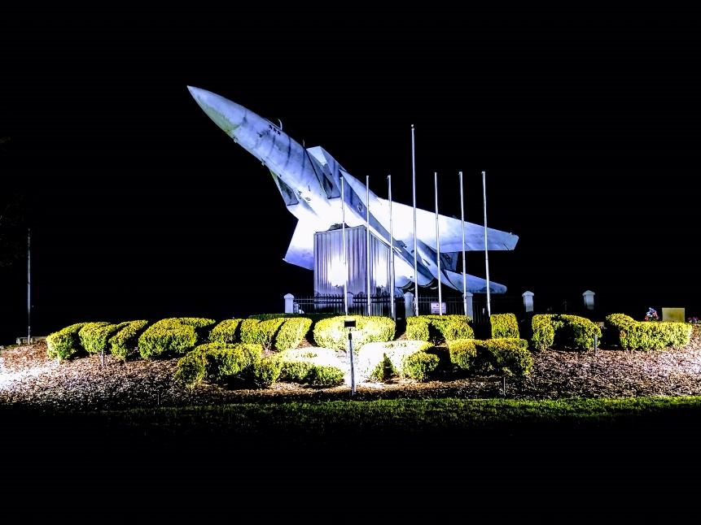
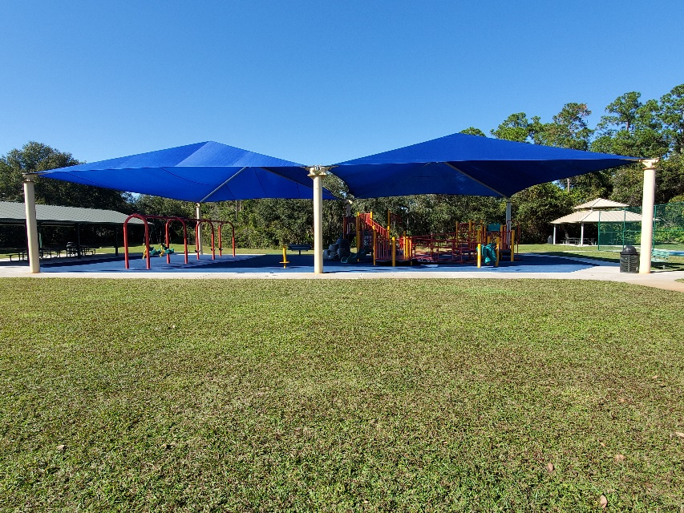
IDEAL CANDIDATE
The City of DeBary seeks a servant leader of high integrity to serve as its next Director of Economic Development. The selected individual must be passionate about public service and enthusiastic about being a part of a growing and dynamic community.
The successful candidate will have a demonstrated track record of creative and entrepreneurial approaches and be willing to consider “outside the box” strategies to address economic development issues and challenges. DeBary is seeking a self-motivated individual, a visionary that can imagine the possibilities, and execute the steps necessary to bring ideas to fruition.
DeBary achieves much with our small, 43-employee staff. We require an independent self-starter for this one-person department. An individual with a proven ability to establish and maintain positive, trusting, and highly productive relationships and work continuously with both internal and external groups to facilitate a strong, high performing team is required. A team builder with a collaborative and proactive management style will be successful in this position. The selected individual will advocate for development opportunities and be a champion for the community.
In addition to experience with marketing concepts inherent with economic development, we are seeking an individual who will share our passion, and provide us with a unique blend of experiences that incorporates site and land development initiatives into our Main Street project.
We are seeking an individual with a Bachelor’s Degree or equivalent in Urban Planning, Economics, Public or Business Administration, Marketing or related field with five (5) years related experience.

Slide 7
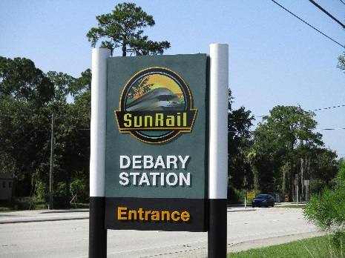
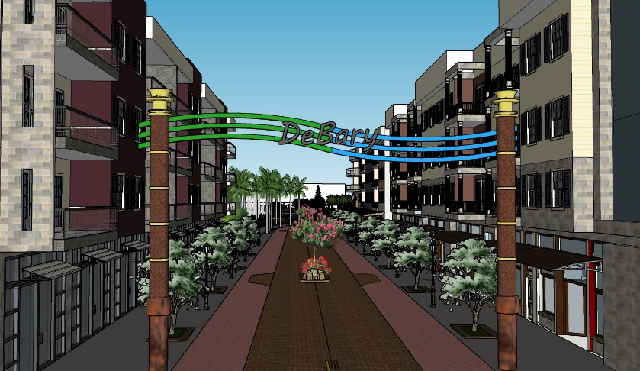
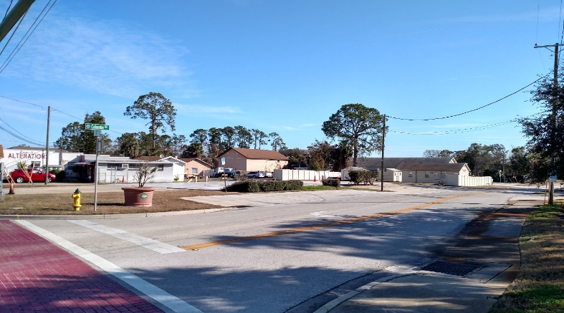
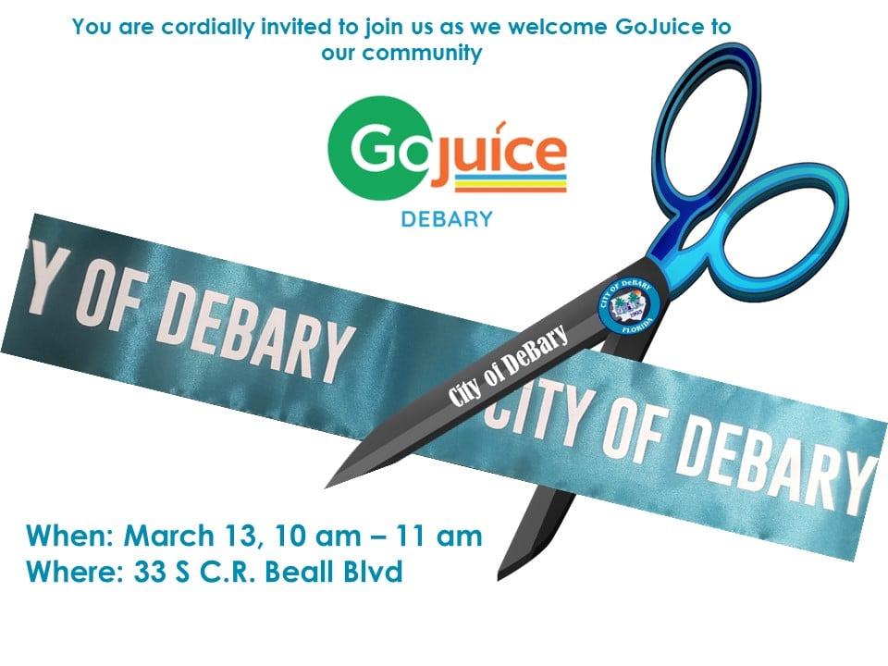
Challenges & Opportunities
DeBary has the northernmost SunRail station in Central Florida. We have developed a Transit-Oriented Development Overlay District to encourage high-density, mixed use growth associated with trending lifestyles.
In our City corridor, marketing in-fill commercial lots, as well as redevelopment opportunities, are key to revitalization and beautification.
Within the TOD, DeBary has designed an area to become a “Main Street.” We do not currently have a downtown, but Leadership envisions a place that will become the heart of the City.
Recognized need to strengthen relationships with current DeBary businesses to enhance our community and promote long-term success.

Slide 8
COMPENSATION & BENEFITS
The salary range for the position is $63,792 - $95,687.88, depending upon qualifications and experience. We offer an excellent benefits program that includes medical, dental, vision, life insurance, and short- and long-term disability and no cost to our employees. Employees receive 20 (twenty) PTO days per year and the City contributes 10% to the employee’s 401(k).
APPLICATION PROCESS
Please apply online: https://debary.org/jobs
For More Information Contact: Wendy Cullen Human Resource Director wcullen@debary.org (386) 601-0217 The City of DeBary is an Equal Opportunity Employer and values diversity in its workforce. Applicants selected as finalists for this position will be subject to a comprehensive background check.

